Slide 1
2006 Pikes peak 10 kilometer run results
Deloitte Skills test
Matthew Jacobsen
5/20/2021

Slide 2
Problem overview
Data provided covered results of pikes peak 10 km run. Using the data provided, create a series of visualizations (e.g., charts, graphs, etc.) that answer the following questions regarding the results of the 2006 Pike’s Peak 10k Race:
What are the mean, median, mode, and range of the race results for all racers by gender?
Analyze the difference between gun and net time race results.
How much time separates Chris Doe from the top 10 percentile of racers of the same division?
Compare the race results of each division.
The following slides will cover the analytical results for each of these questions.
Details of the data processing are included in the Jupyter Notebook delivered along with this powerpoint.

Slide 3
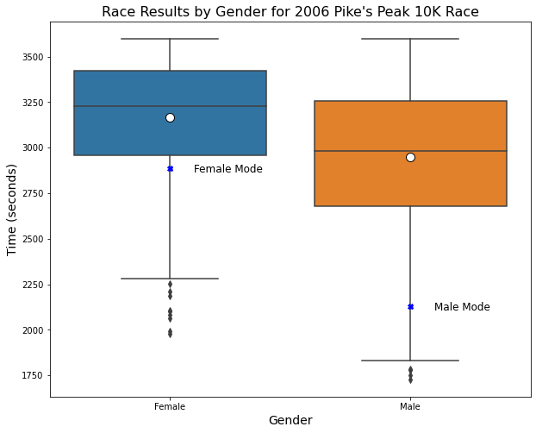
Question 1: What are the mean, median, mode, and range of the race results for all racers by gender?
In the figure to the right, Our analysis shows the following results in seconds.
Measure | Males | Females
Mean | 2949 | 3168
Median | 2981 | 3226
Mode | 2128 | 2886
Range | 1727-3597 | 1978-3599

Slide 4
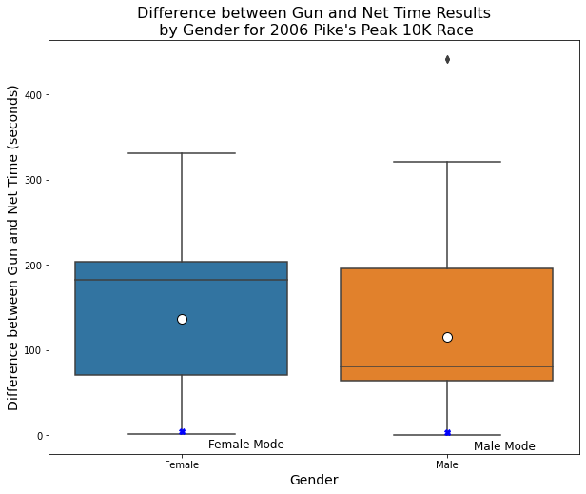
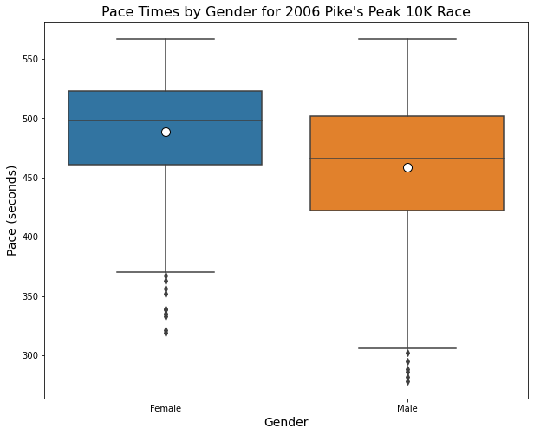
Question 2: Analyze the difference between gun and net time race results.
From our analysis, gender appears to be a primary driver in the difference between gun and net times.
In the graph to the Top right, the mean times are similar, but the median times are much higher for women than men.
This seems to indicate that women racers, on the whole, started after the male racers.
This could have implications for any conclusions drawn off of this data, as the first runners are more likely to start out at a faster pace, as they will have fewer runners in their way.
In contrast, runners starting later will be limited in their pace by the runners ahead of them.
This is confirmed by looking at the graph to the bottom right, which shows clearly that the distribution of Women’s pace times is shifter higher than the men’s times.

Slide 5
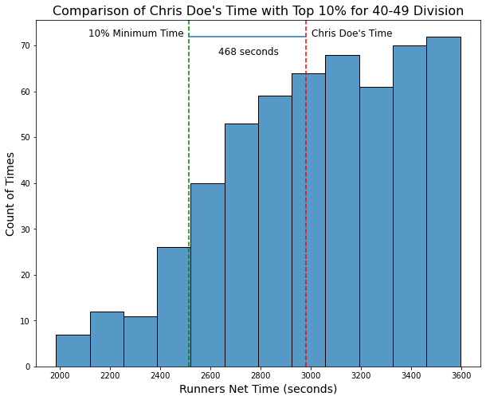
Question 3: How much time separates Chris Doe from the top 10 percentile of racers of the same division?
In our analysis, we found that Chris Doe was slower than the top 10th percentile of runners by 468 seconds.
This difference is when compared against all runners in the 40-49 age division and against just the male runners from this division

Slide 6
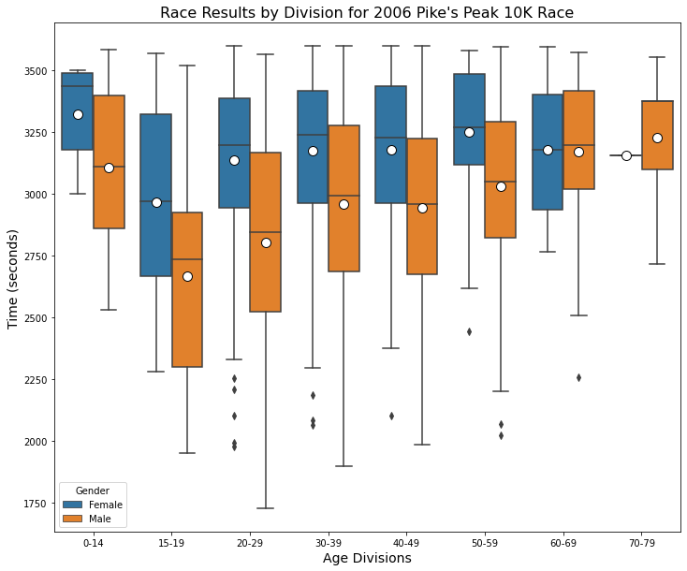
Question 4: Compare the race results of each division
From our analysis of the race results for each division, we can see that the fastest times for both men and women occurred in the 20-29 age division.
The men’s results show a clear peak that drops off on either the older or younger divisions
In contrast, the women’s results show a sustained mean and range of times across the 20, 30, and 40-49 year age divisions.
Therefore, we can conclude that the athletic capacity of women runners is sustained over a longer age range.
It is possible this sustainment extends further, but the lower amount of data prevents such conclusions from being drawn.

